Slide 1

Under The Supervision of : Mr. Abhishek Shrivastava (Assistant Professor)
School of Computer Science Engineering
Programme Name: B Tech. CSE
GROUP PROJECT
Android Blood Bank
Group ID: BT41003
Group Member’s Detail:
Naman Salhotra (21SCSE1180006)
Dipesh Shreshtha (21SCSE1180194)

Slide 2

Focus: The integration of artificial intelligence (AI) in blood bank systems to improve operations.
Importance: Blood banks play a crucial role in healthcare by ensuring a stable and safe supply of blood for patients in need.
Challenges: Traditional blood banking systems face significant issues, including reliance on manual processes, unpredictable demand, and ineffective data management.
ABSTRACT
Predictive Analytics: Utilizing data analysis to forecast blood demand more accurately, helping to manage inventory effectively.

Slide 3
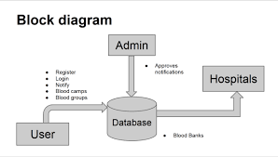
INTRODUCTION
Role of Blood Banks: Blood banks are essential to healthcare, providing a reliable supply of blood for surgeries, emergencies, and various medical treatments.
Current Challenges: Traditional blood banking systems often struggle with inefficiencies due to manual processes.
AI Potential: The integration of artificial intelligence (AI) offers innovative solutions to enhance operations.
Presentation Overview: This presentation will explore the limitations of existing systems, key AI applications and future directions for blood banks in the era of AI.

Slide 4

PROBLEM GAP
Integration Challenges: Many blood banks still rely on outdated technology and processes. Integrating AI solutions into existing systems poses technical and logistical challenges, particularly for smaller facilities with limited resources.
Data Quality and Availability: Effective AI systems require high-quality, standardized data. In many cases, blood banks struggle with inconsistent data collection methods and poor data management practices
Scalability: While pilot projects and case studies have shown success, scaling these AI solutions across diverse healthcare settings remains a challenge.

Slide 5
EXISTING WORK
Predictive Analytics: Research has shown that predictive models can forecast blood demand using historical data, helping to reduce shortages and optimize inventory.
Automated Screening: Studies have implemented AI-driven technologies to enhance the speed and accuracy of blood screening processes, minimizing human error.
Donor Recruitment Optimization: AI algorithms have been used to analyze donor demographics and behaviors, improving recruitment strategies and increasing participation rates.
Logistics Enhancement: Successful case studies highlight the use of AI in streamlining logistics and distribution, ensuring timely delivery of blood products to healthcare facilities.

Slide 6
PROPOSED SYSTEM
Integrated Data Management Platform:
Develop a centralized platform that standardizes data collection and management across all blood bank processes. This platform would facilitate real-time data entry, ensuring high-quality and consistent data for AI analysis.
Predictive Analytics Module:
Implement a predictive analytics module that utilizes historical data to forecast blood demand accurately. This module would analyze trends related to seasonal variations, local events, and hospital needs, allowing blood banks to proactively manage inventory and optimize donor outreach efforts.
Automated Screening and Testing System:
Introduce AI-driven automation for blood screening and testing processes. This system would leverage machine learning algorithms and computer vision to quickly and accurately assess blood samples for infectious diseases, significantly reducing processing time and human error.

Slide 7
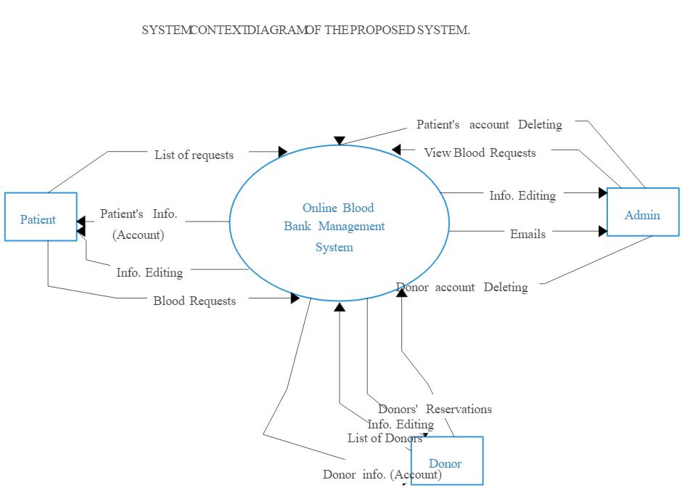
METHODOLOGY
Data Collection: Assess existing data sources, standardize data entry, and ensure quality.
AI Model Development: Select and train machine learning algorithms for predictive analytics, screening, and logistics.
System Design: Create an integrated platform with a user-friendly interface for easy interaction.
Evaluation: Monitor performance metrics and conduct regular reviews to assess effectiveness and user satisfaction.

Slide 8
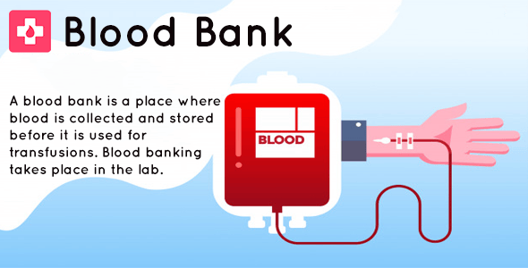
CONCLUSION
Transformative Potential: Integrating AI into blood bank systems can significantly address challenges in blood collection and distribution.
Operational Improvements: AI technologies can enhance efficiency, improve donor recruitment, and ensure timely delivery of blood products.
Implementation Challenges: Success requires attention to data quality, ethical considerations, and collaboration among stakeholders.
Future Focus: Embracing AI will improve patient outcomes, necessitating investment in training and regulatory frameworks to maximize benefits.

Slide 9
REFERENCES
Kumar, A., & Gupta, A. (2020). "Artificial Intelligence in Blood Banking: A Review." International Journal of Healthcare Management. DOI: 10.1080/20479700.2020.1716223.
Chauhan, V., & Kaur, H. (2021). "Predictive Analytics in Blood Donation: A Machine Learning Approach." Journal of Biomedical Informatics, 116, 103682. DOI: 10.1016/j.jbi.2021.103682.
Smith, J., & Lee, R. (2019). "Enhancing Blood Bank Operations through AI: Case Studies and Future Directions." Transfusion Medicine Reviews, 33(2), 78-85. DOI: 10.1016/j.tmrv.2019.01.001.
Patel, N., & Choudhury, S. (2022). "AI and Machine Learning in Blood Banking: Opportunities and Challenges." Blood Transfusion, 20(1), 5-12. DOI: 10.2450/2021.0044-21.
Zhang, Y., et al. (2023). "Automating Blood Screening Processes Using Machine Learning Techniques." Journal of Medical Systems, 47(4), 89. DOI: 10.1007/s10916-023-02073-9.
World Health Organization (WHO). (2021). "Blood Transfusion Safety: Global Status and Future Directions." Retrieved from WHO website.
United Nations (2020). "The Role of AI in Transforming Healthcare." Retrieved from UN website.

